Slide 1

Quick Guide
PSR03-A Keyfob Remote
Philio Technology Corporation
EASYFIKS SMART HOME

Slide 2


Where to Use

Slide 3
PAD Quick Guide

Slide 4
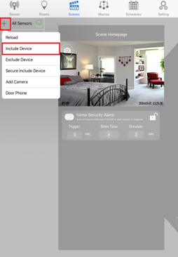

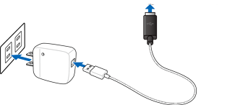
Include Device
1. Plug Smart Plug into the outlet.
2. While device is in including mode, click on the + icon and select “Include Device”.

Slide 5
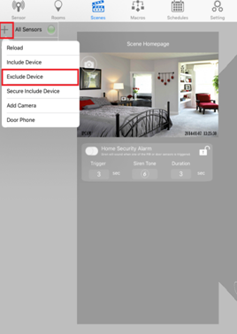
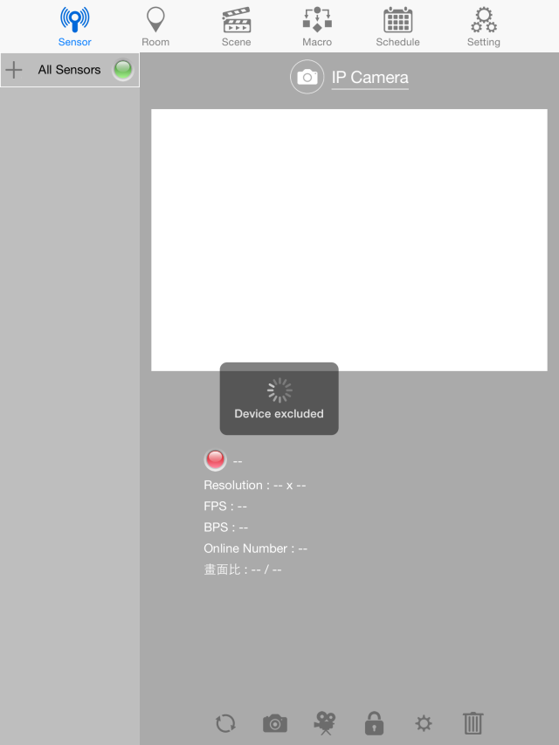

Exclude Device
1. Click on the + icon and select “Exclude Device”.
2. Press middle button and the disarm button together three times.
3. If successful, “Device excluded” will show on APP.

Slide 6
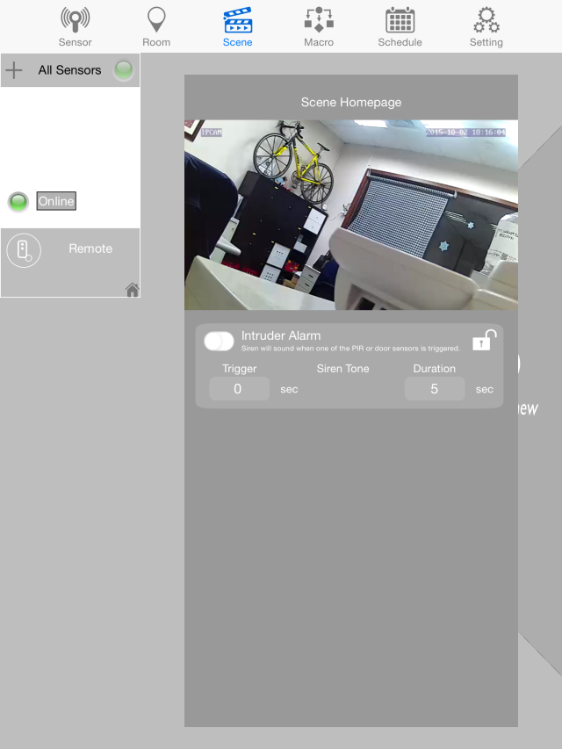
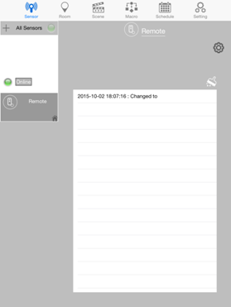
Sensor Settings
1. Click on the sensor you want to see the information and settings.
2. A new window will open with the information.

Slide 7
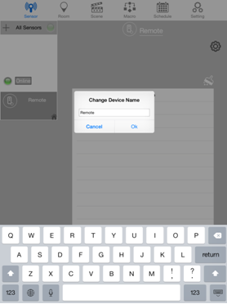
Sensor Settings
Change Name
1. Click on the name of the sensor.
2. Change the name of the sensor and click OK.

Slide 8
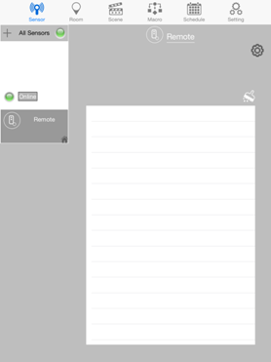
Sensor Settings
Delete Information
1. To delete the information, click on the brush tool
2. Once click all the information will be removed.

Slide 9
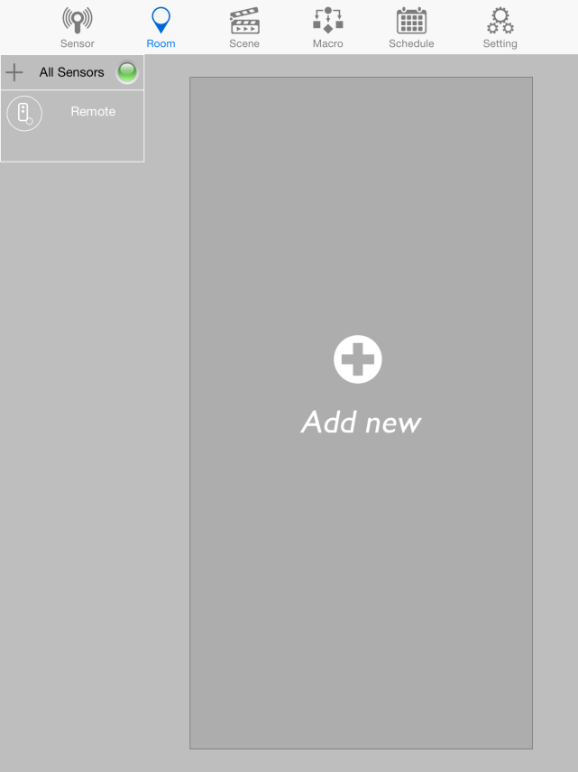
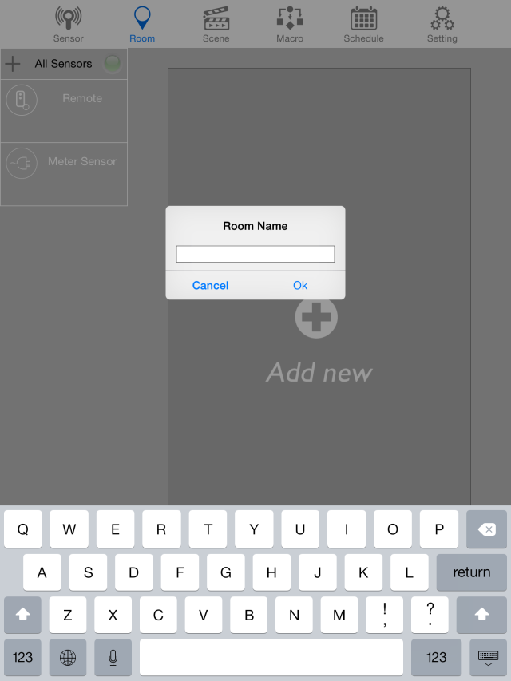
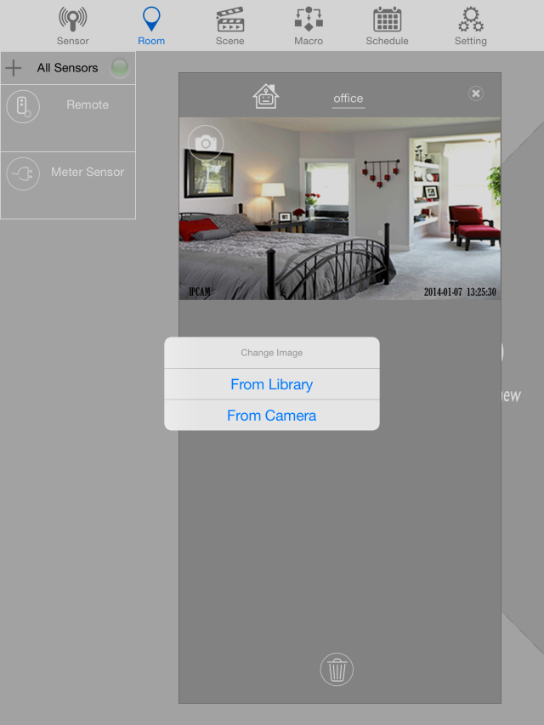
Room Settings
Add new Room I
1. on Room section, to make a new room click “Add new”
2. provide a name for the room
3. a new window will be formed to sort the sensors and you can choose photo from library or camera by clicking camera icon.

Slide 10
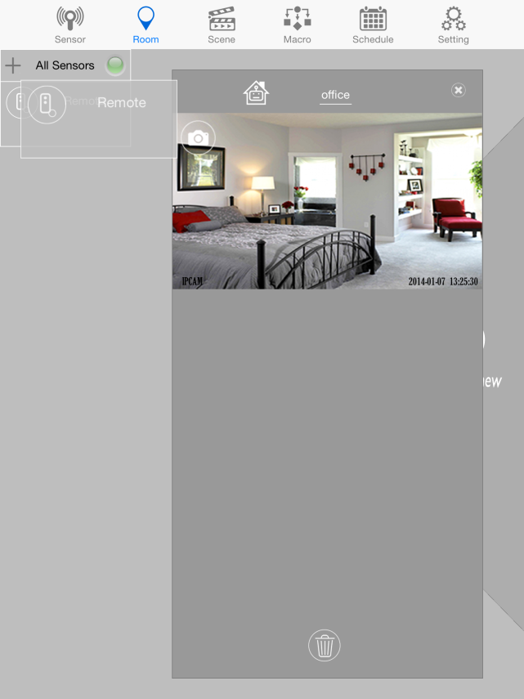
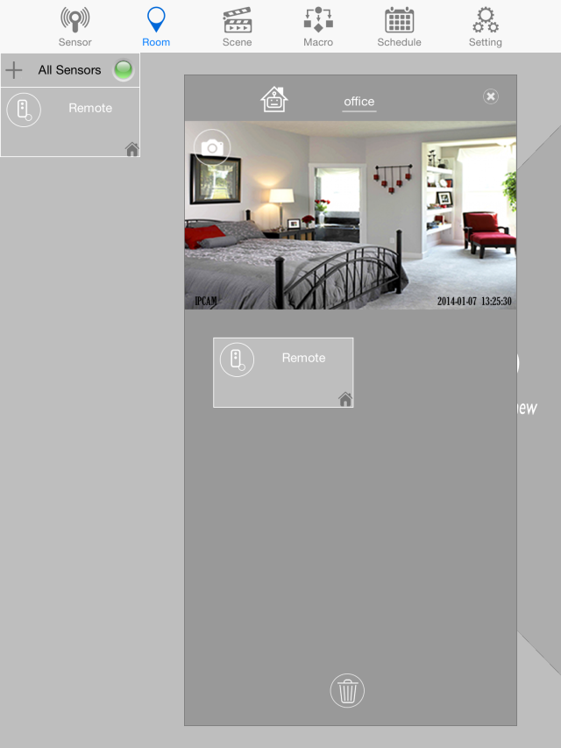

Room Settings
Add new Room II
Once a sensor has already been placed in a room , there will be this icon. This means this sensor can't be on another room.
4. Click the sensor until it floats, and drag it to the new window
Note: There's no limitation to the number of rooms created or the number of sensors placed in one room.

Slide 11
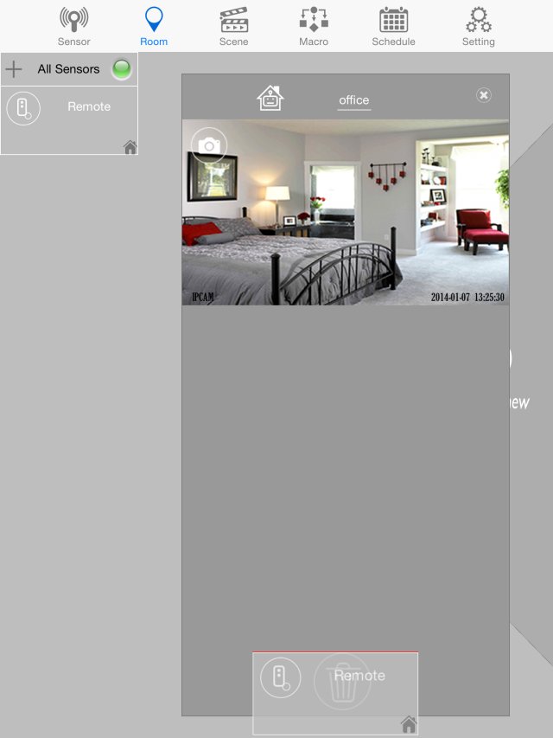


Room Settings
Delete Sensors in the Room
The house icon is also removed.
1. click the sensor inside the room until it floats, and drag it to the trash icon
2. once deleted, the sensors will not be seen in the room

Slide 12
Room Settings
Delete Room
1. to delete a room, click the “x” icon on the upper right part of the window
2. once deleted, it back to “Add new” page

Slide 13
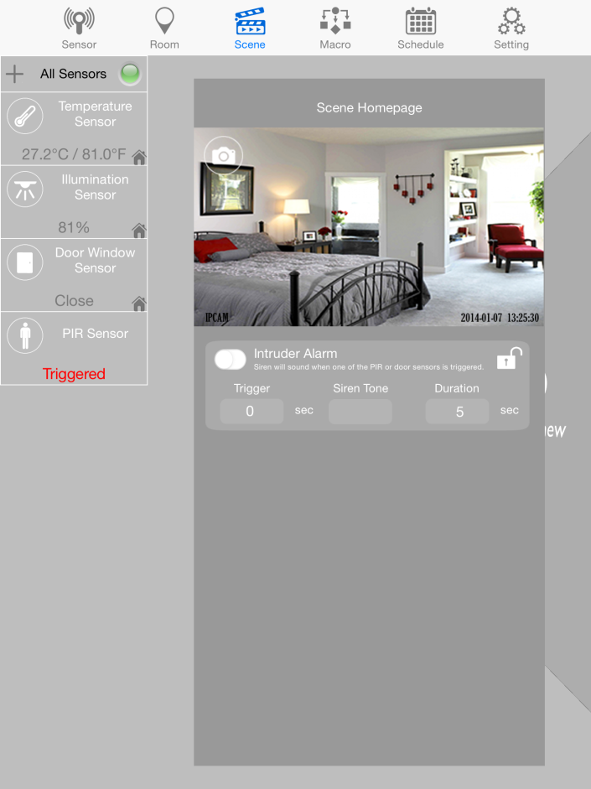
Scene Settings
A. Intruder Alarm
To activate armed and disarmed mode
during armed mode, the padlock icon will be close, and disarmed mode, padlock will be open
Trigger: allows you to set the duration for triggering the alarm in armed mode
Siren Tone: allows users to decide which tune of siren to be used. There are six tones to choose from
Duration: set the duration of the alarm
Note: Only Siren, Meter, Curtain Dimmer or Switch can be added in Scene

Slide 14
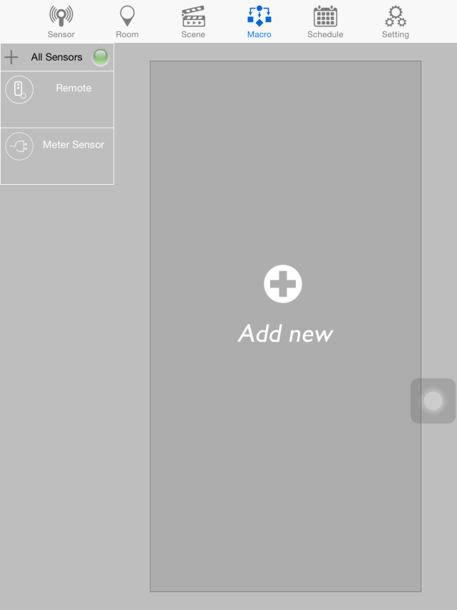
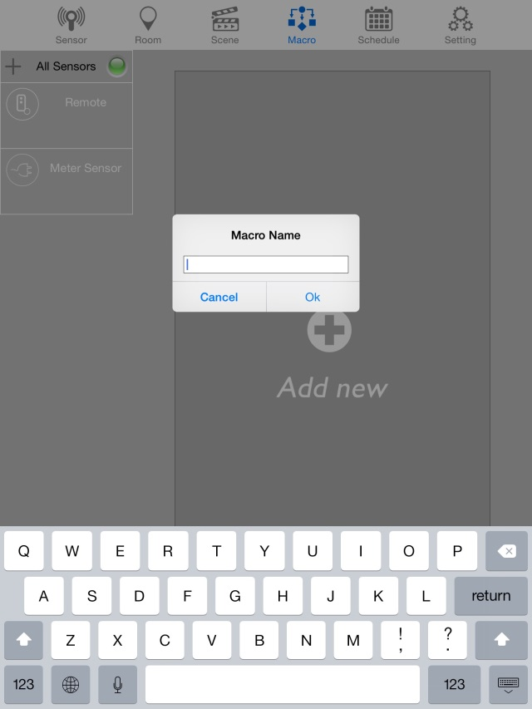


Macro Settings
A. Add new Macro
Scene - Remote
If System Armed
Then Power off
Plug
1. click “Add new” to make a new macro
2. provide a name for macro and click OK.

Slide 15
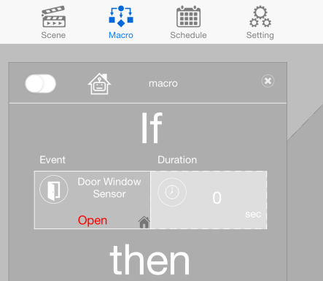
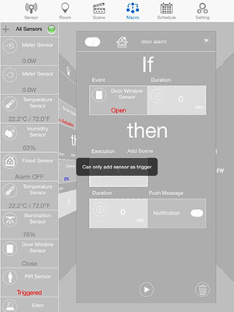
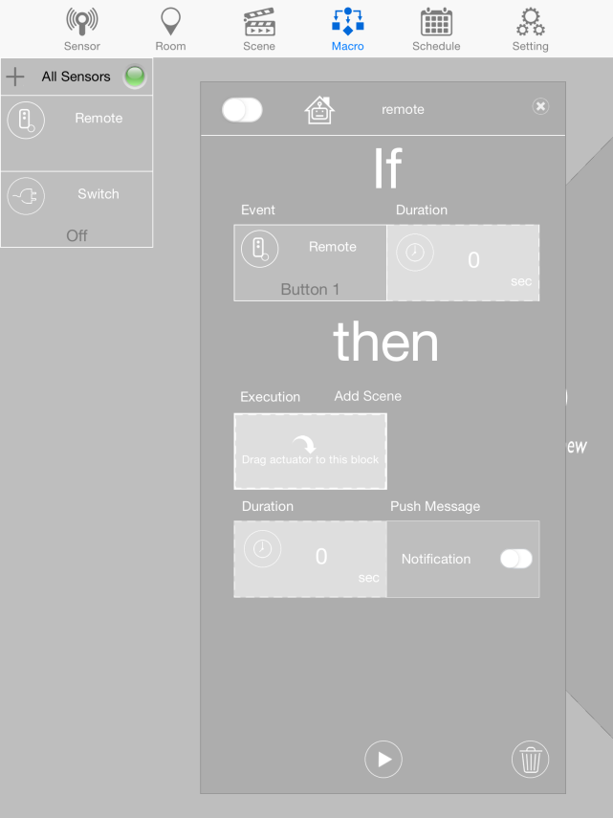
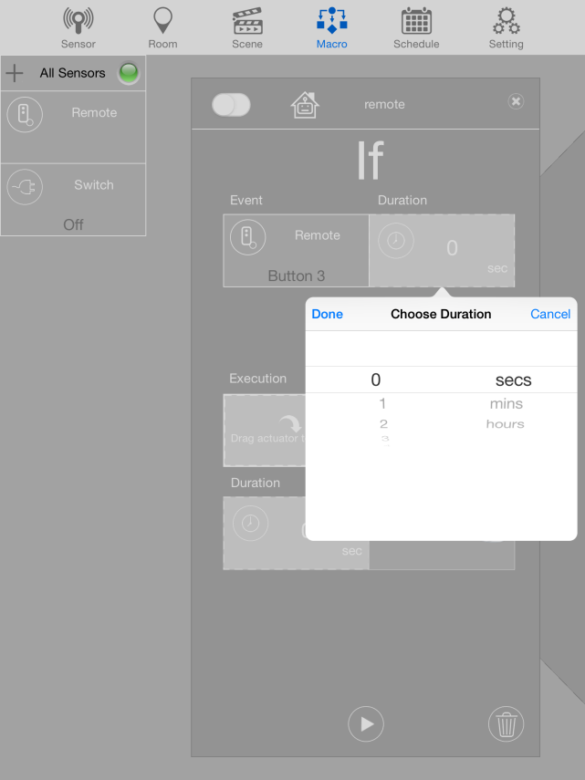
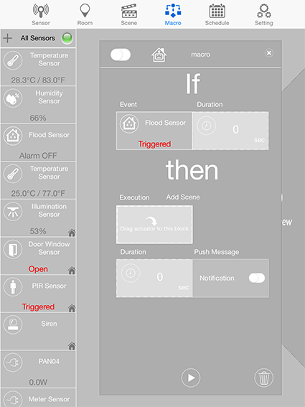
Macro Settings
B. Setting up IF
3. click and drag the sensor that you want an event to occur
4. to specify the duration, click the duration and set the time
5. only sensors can be placed on the event and not switches

Slide 16

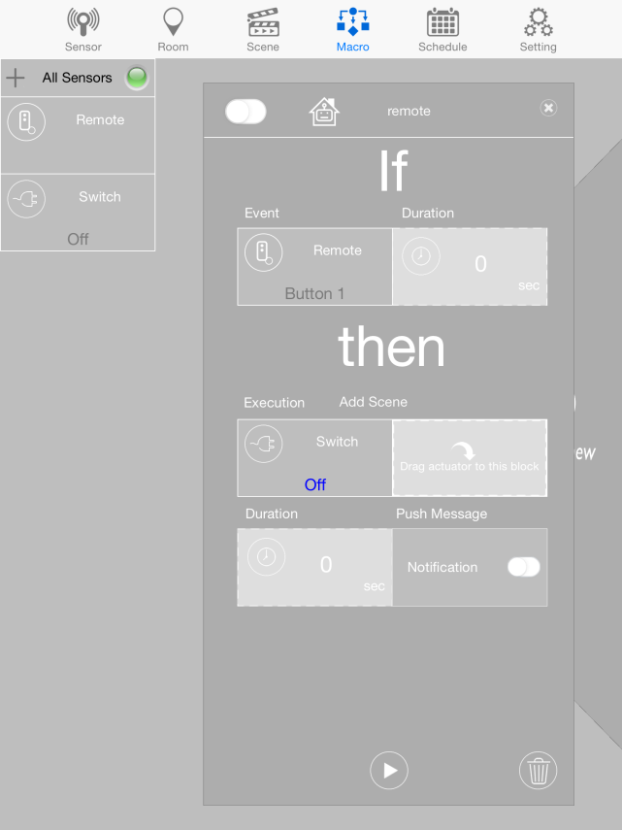
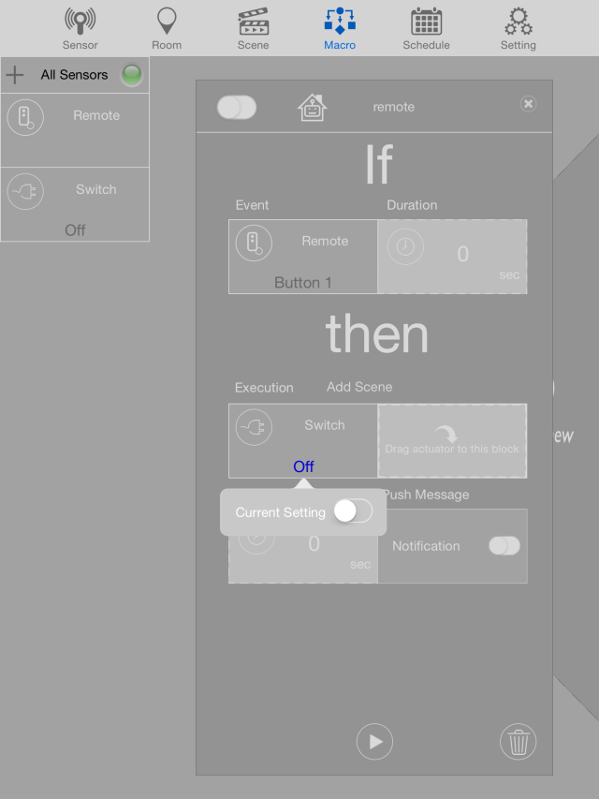
Macro Settings
B. Setting up Then
6. for the Execution, you can either add actuators or add scene.
7. click and drag the actuators that you want to react to your “If”
8. to set up the actuator, click on the actuator itself and choose from the options

Slide 17
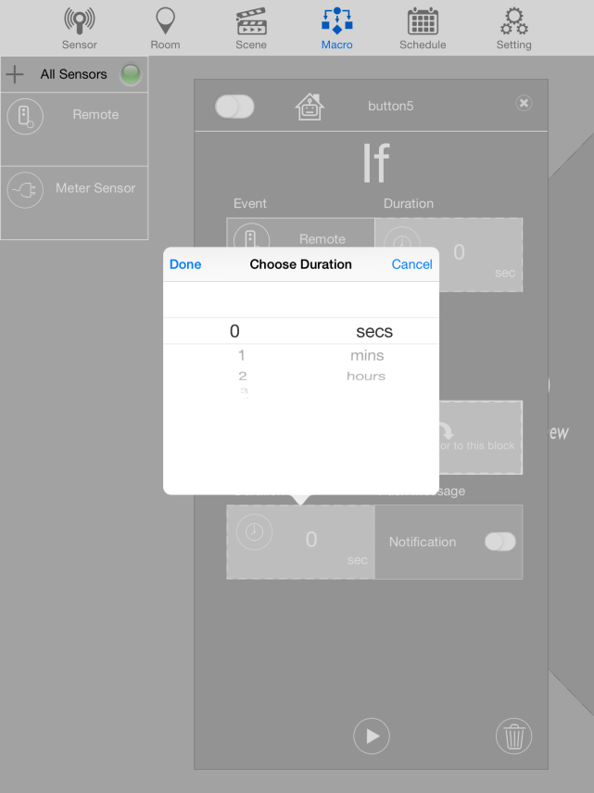
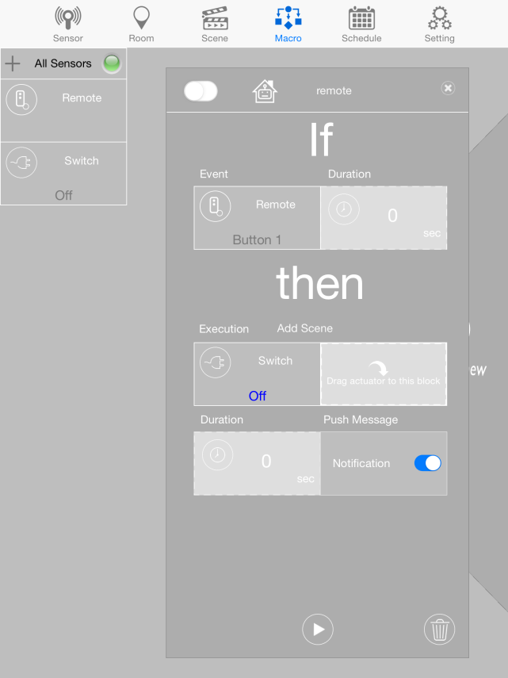
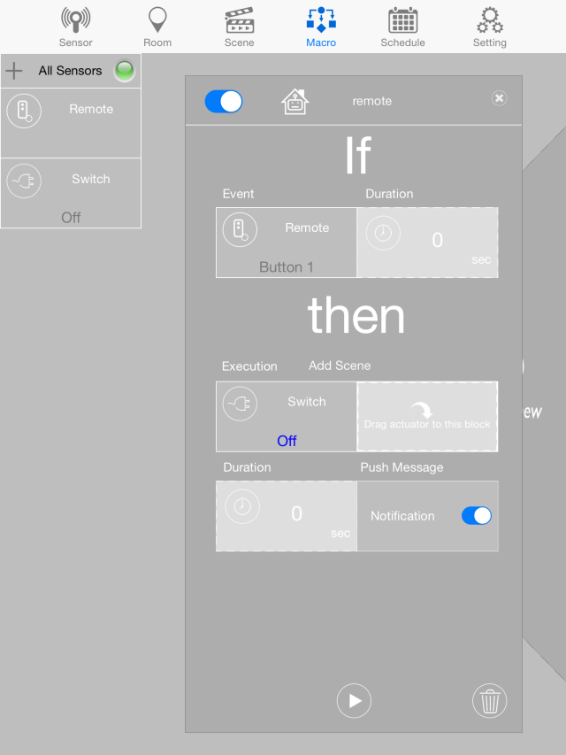
Macro Settings
B. Setting up Then
11.
12.
9. to specify the duration, click the duration and set the time
10. to receive alert if triggered, tap the switch beside the notification
11. To turn on the Macro, tap the this icon switch
12. to try to play the macro, click on the play icon.

Slide 18
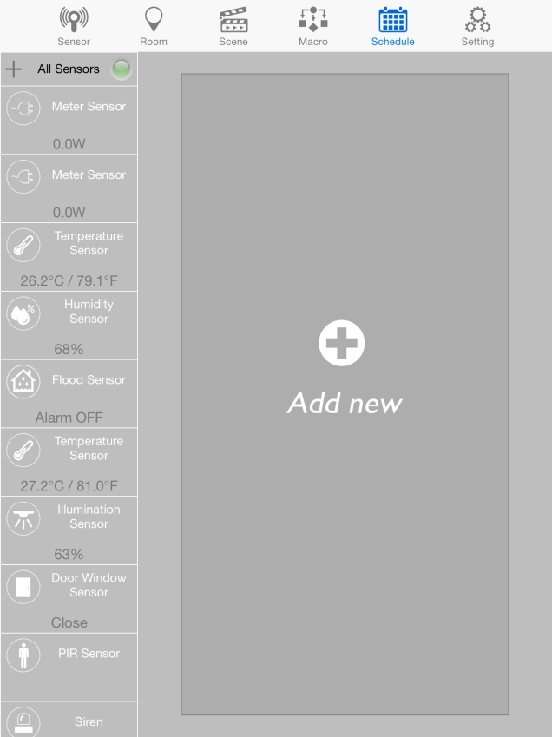
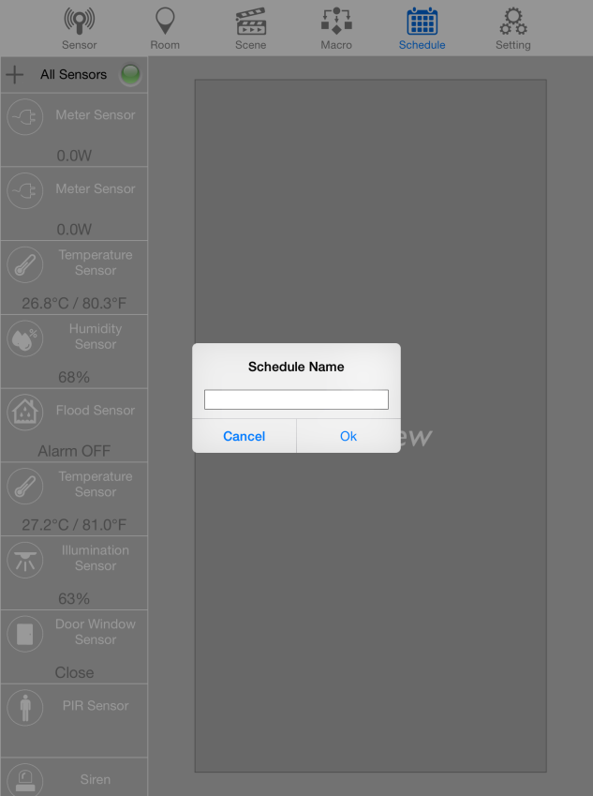
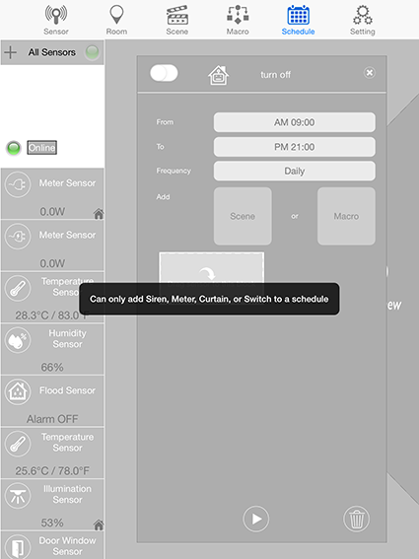
Schedule Settings
1. click “Add new” to make a new schedule
2. provide a name for schedule and click OK.
Note: Only Siren, Meter, Curtain Dimmer or Switch can be added in Schedule

Slide 19

EASYFIKS SMART HOME
Notes:
19
19

